Slide 1
Welcome to
Online Food Ordering Management System

Slide 2
Introduction
Online ordering system that I am proposing here, greatly simplifies the ordering process for both the customer and the restaurant. System presents an interactive and up-to-date menu with all available options in an easy to use manner. Customer can choose one or more items to place an order which will land in the Cart. Customer can view all the order details in the cart before checking out. At the end, customer gets order confirmation details. Once the order is placed it is entered in the database and retrieved in pretty much real time. This allows Restaurant Employees to quickly go through the orders as they are received and process all orders efficiently and effectively with minimal delays and confusion.

Slide 3
What To Do
provide a display that will allow the customer to choose menu items and make corrections.
update this display with changes to the order.
provide a running total cost and calorie/fat count.
At order finalization, we will request identification information from the customer.
offer a static map of our surrounding area so that customers unfamiliar with our location can find us.

Slide 4
MODULES
Admin
User Module
Contact Us Module
Search Module

Slide 5
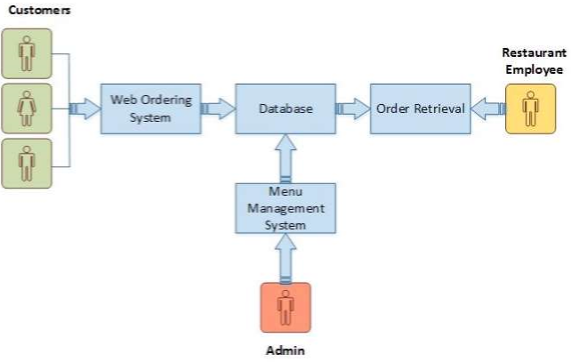
Program Requirements

Slide 6
Web Ordering System Module
Create an account.
Manage their account.
Log in to the system.
Select an item from the menu.
Add an item to their current order.
Review their current order.
Remove an item/remove all items from their current order.
Provide payment details.
Place an order.

Slide 7
Menu Management System Module
Add/update/delete food category to/from the menu.
Add /update/delete food item to/from the menu.
Update price for a given food item.
Update additional information (description, photo, etc.) for a given food item.

Slide 8
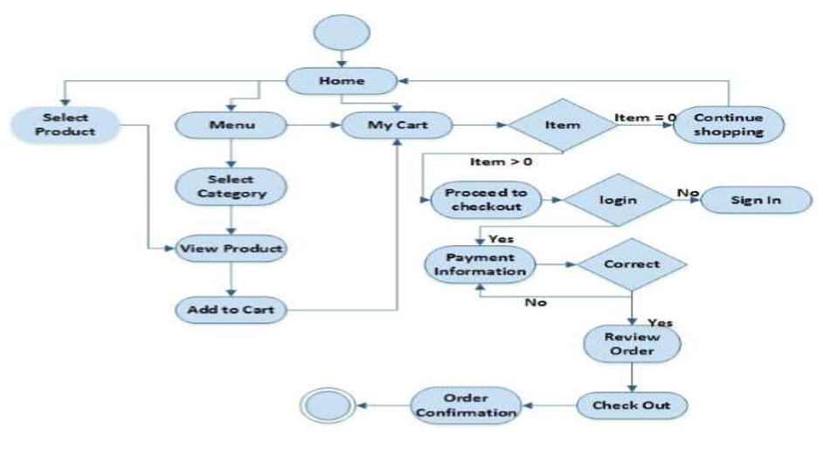
Activity Diagram

Slide 9
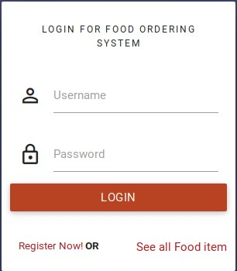
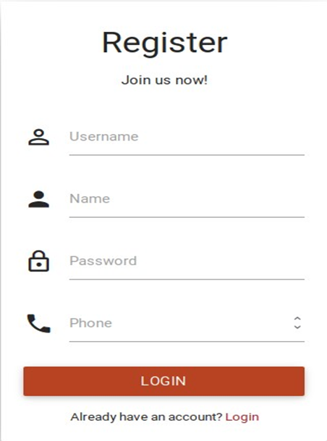
Login and Registration Form

Slide 10
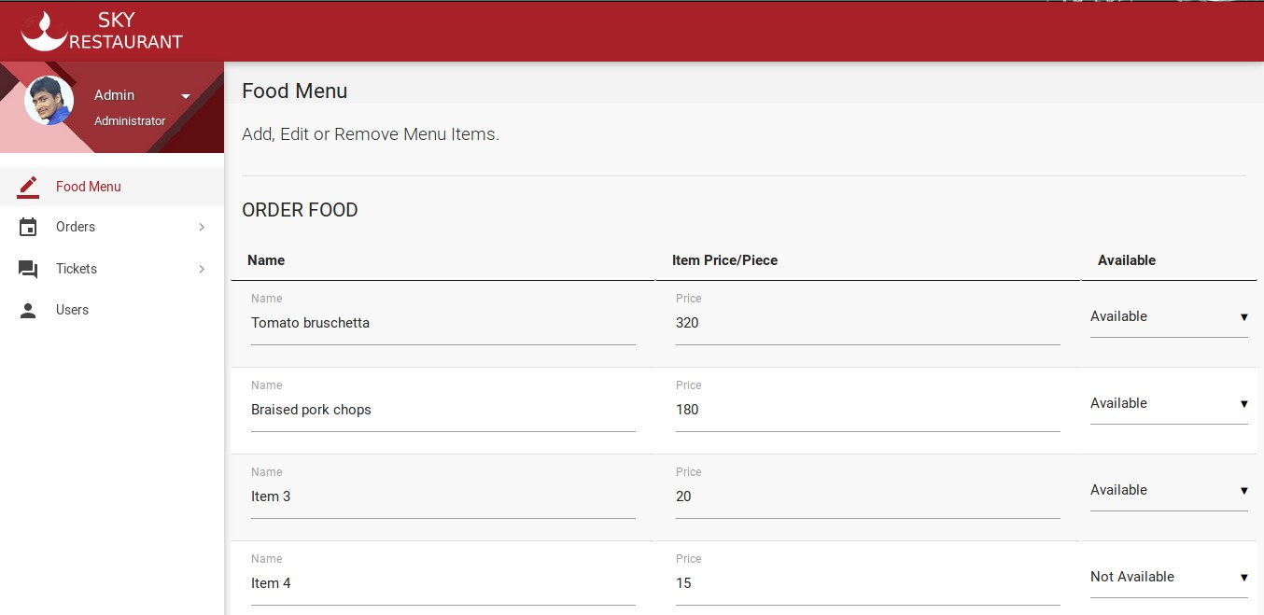
Admin pane

Slide 11
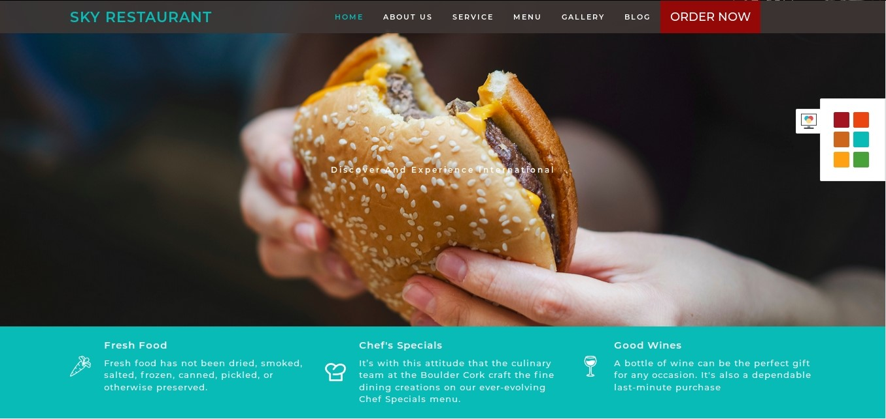
Home page

Slide 12
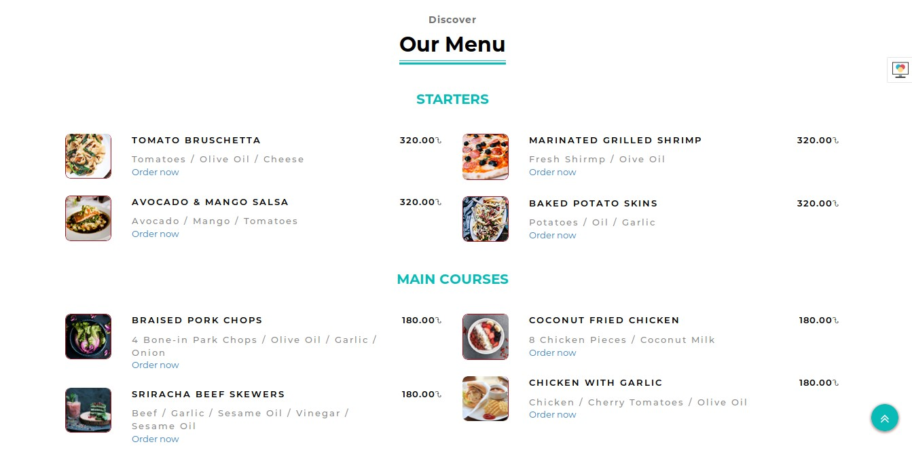

Slide 13
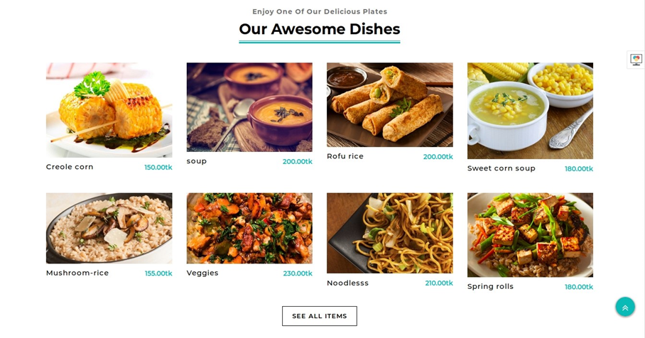

Slide 14
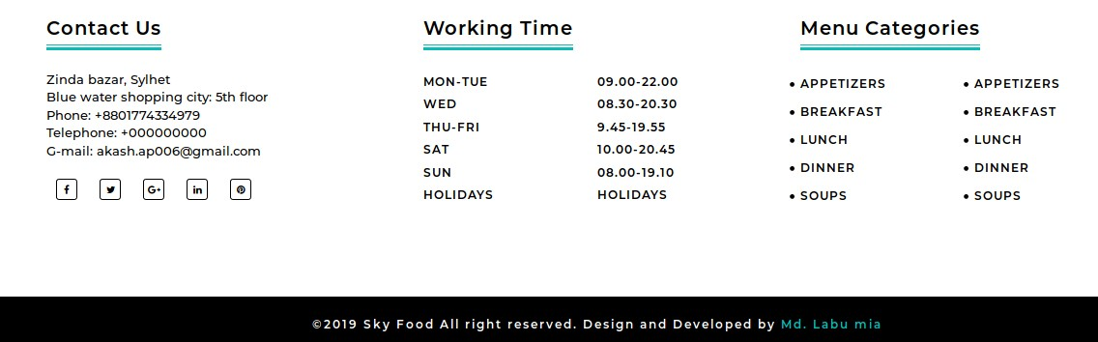
Contact us

Slide 15
Unit Testing
In the web based application smallest testable unit is Web page itself. So the web pages of the site are to be unit tested.
Each web page contains content, navigational links, and processing elements (scripts, event handlers, etc.) .The testing will be driven by the content processing, and links contained in the site.

Slide 16
System Testing
The uncovered weaknesses that were not found in earlier tests are removed in system testing.
The system is corrected such away that it does not affect the forced system failure.
This testing is done with low volume of transaction based on live data. Finally the total system is also tested to ensure that no data are lost.

Slide 17
THANK YOU

